Slide 1
Aaron’s budding staff

Slide 2
Worship
Focus on God.
Listen to your teachers (cos they are helping you to focus).
Be sincere.
Colossians 3:23
“Whatever you do, work at it wholeheartedly as though you were doing it for the Lord and not merely for people.”
https://youtu.be/u88AiyFKJ6g

Slide 3
RECAP

Slide 4
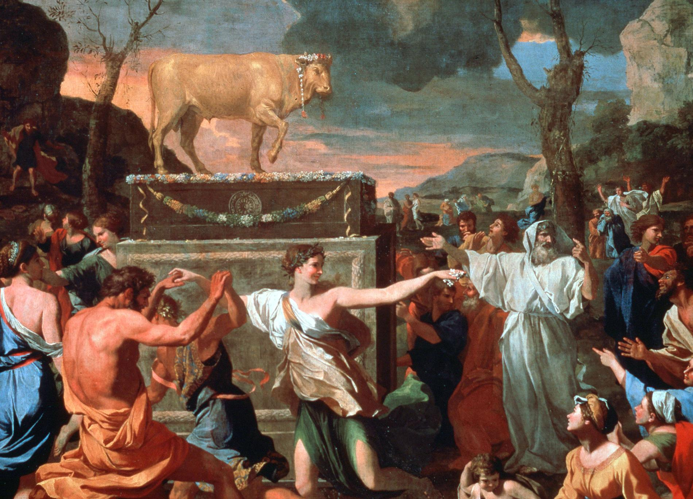
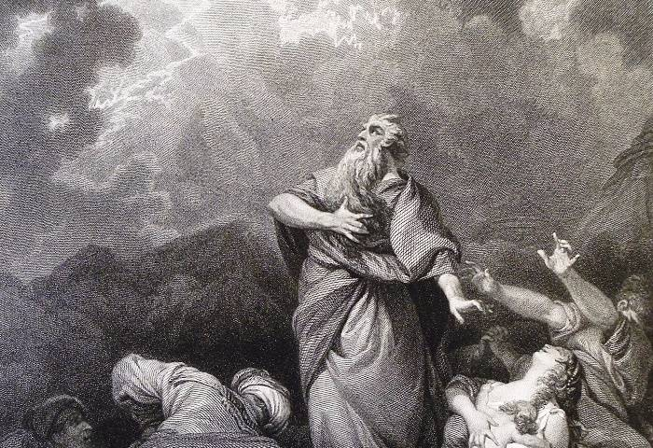
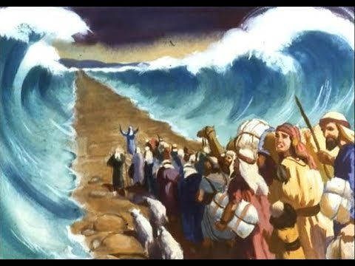
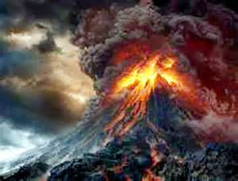
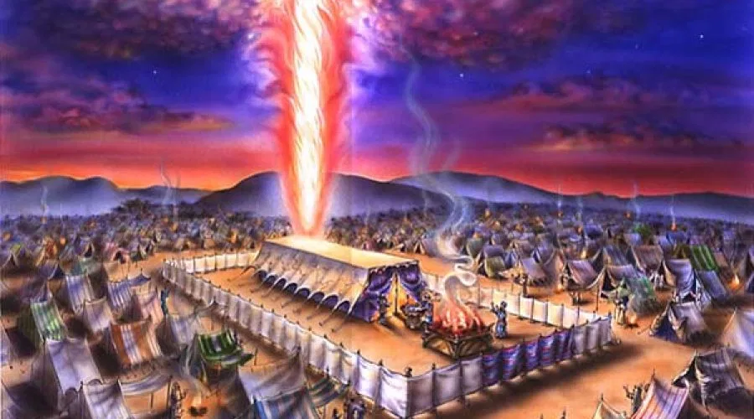
God loves Israel and displays his love in real action
Israel rebelled against God despite God telling them not to make images of God
God’s anger and refusal to go with them
(they were destroying themselves by rebelling against God’s kindness)
God chooses Moses to plead for Israel
God’s forgives them and relationship to Israel is restored
God loves you and wants you to love him too
We rebel against God and go our own way as enemies of God (sin)
God needs to punish our sin by condemning us to death
God chooses Jesus to plead for us
God’s relationship to us is restored (if you turn away from sin and follow Jesus)

Slide 5
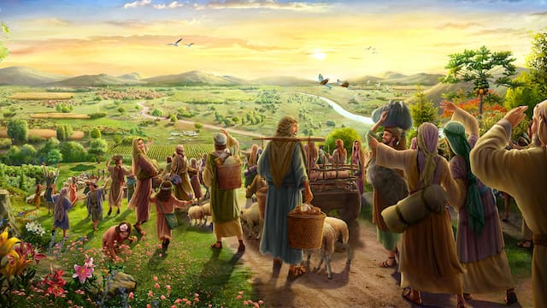
The Israelites FINALLY reached the border to the Promised Land!
But once again they did a very evil thing…

Slide 6
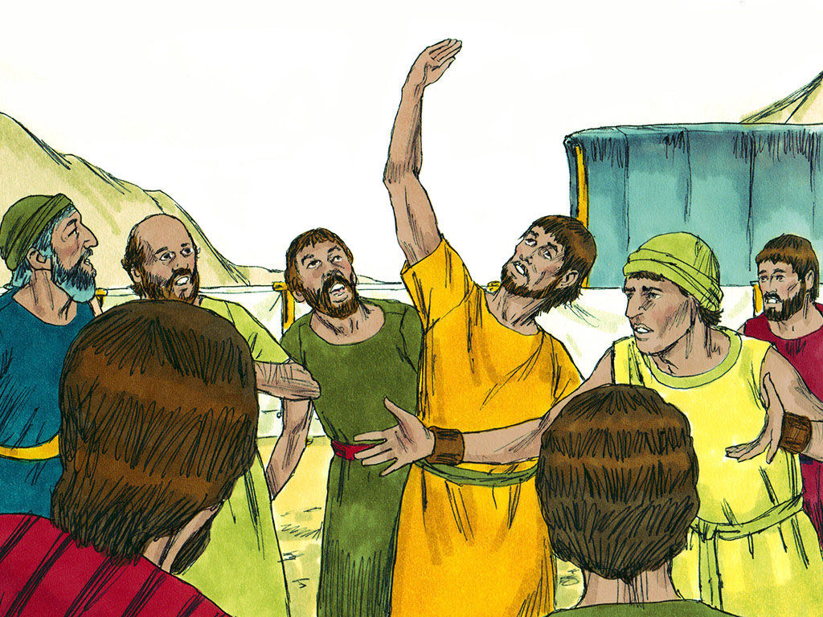
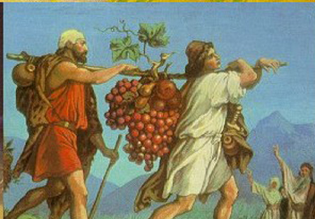
They doubted God and refused to enter the Promised Land!
Was Israel happy with the job Moses was doing?

Slide 7
LESSON

Slide 8
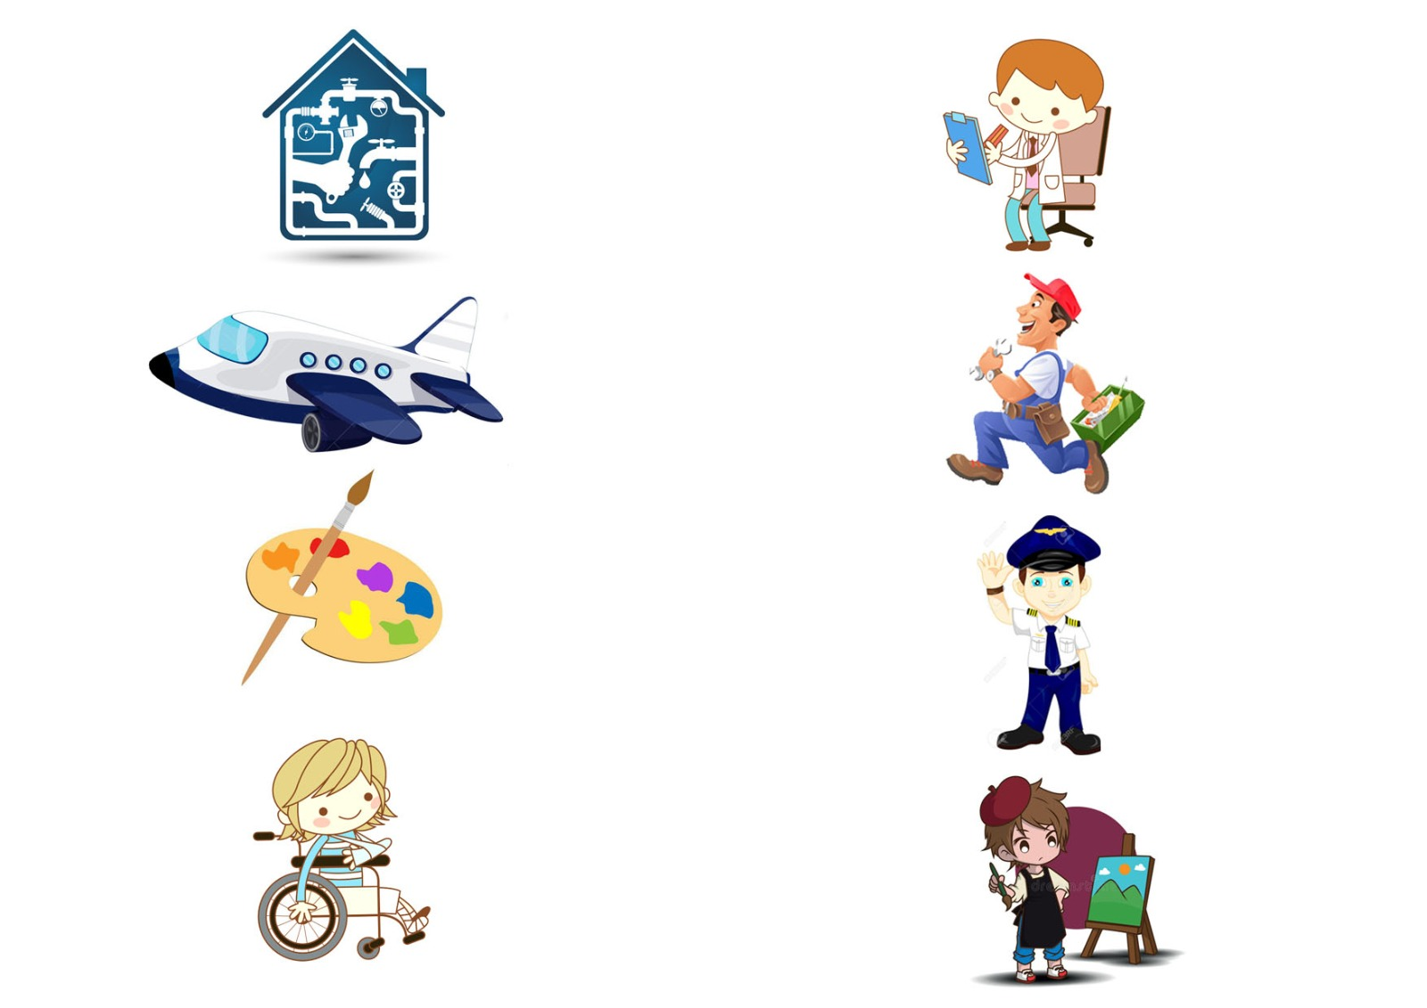

Slide 10
Big IDEA
God proved that Aaron was Israel’s priest. Aaron saved the Israelites from death.
Jesus is a better priest than Aaron because he saves us from death forever

